Slide 1

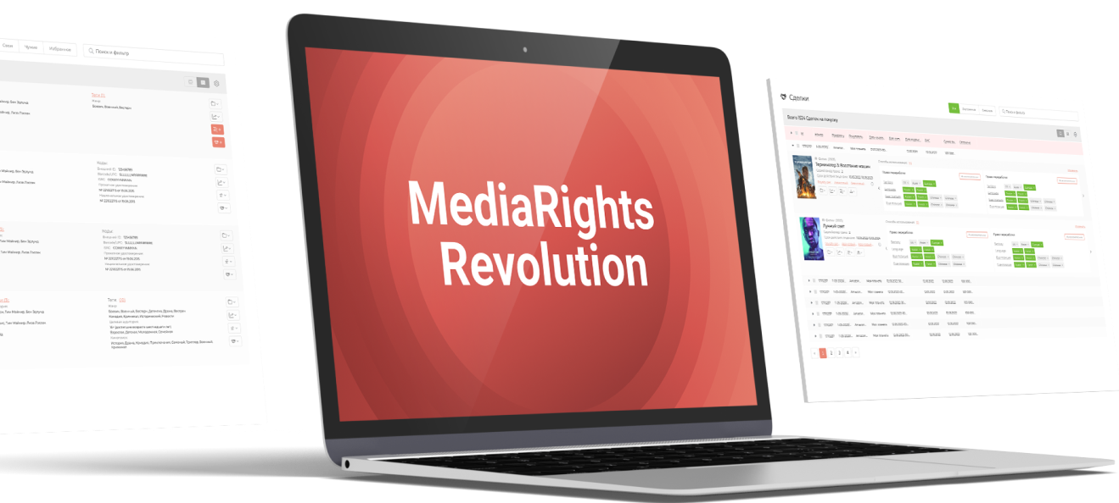
MediaRights Revolution
one platform for all tasks
Comfortable. Transparent. Affordable
for businesses and individuals
https://www.mr2.info/
+382 (69) 57 06 60
info@mr2.info

Slide 2

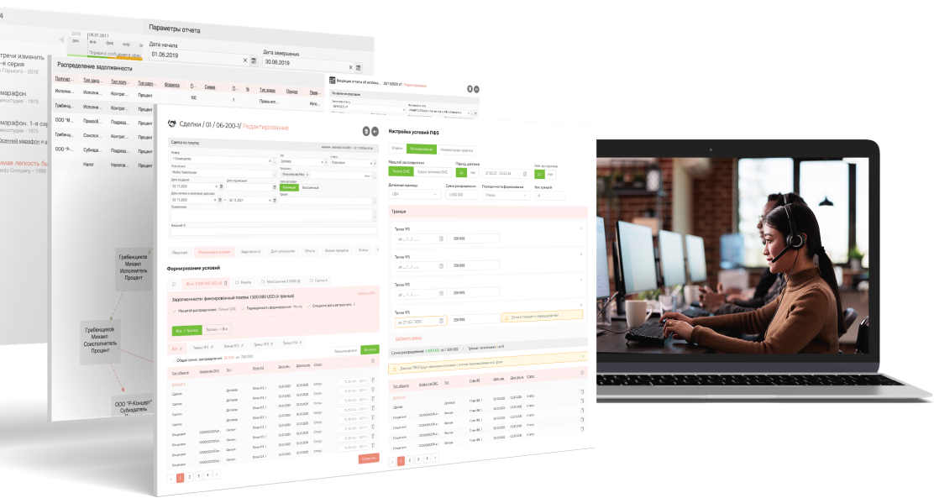
What are media companies losing money on?
Rights availability checking and searching for additional conditions on contracts takes a lot of resources
Absence of a unified register of rights often leads to errors and risks
Rights clearing process is long, difficult and expensive
With growing IP catalog, it is necessary to increase the staff
Why not automate routine tasks?
Media Rights Revolution (MR2) free up at least 40% of your time
https://www.mr2.info/
+382 (69) 57 06 60
info@mr2.info

Slide 3
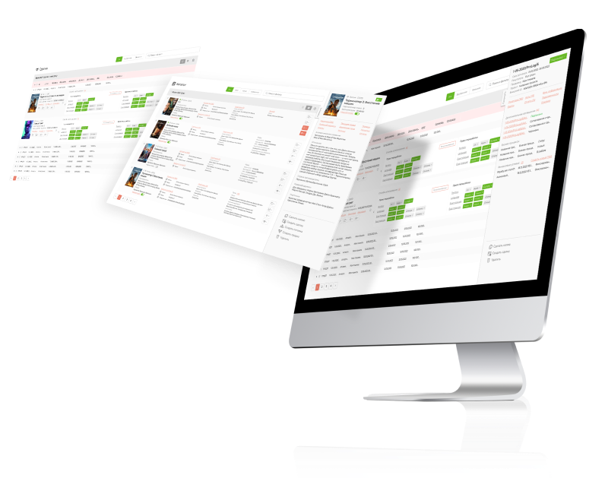
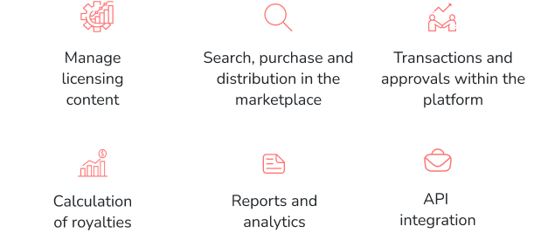
Copyrights, finances and reporting are in order
Intellectual property is the new currency.
MediaRights Revolution (MR2) is a new formula for success.
https://www.mr2.info/
+382 (69) 57 06 60
info@mr2.info

Slide 4
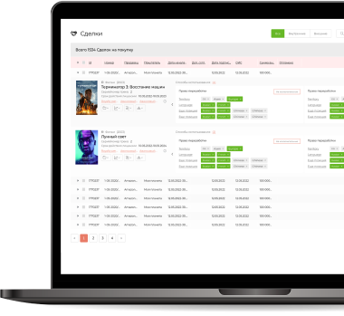
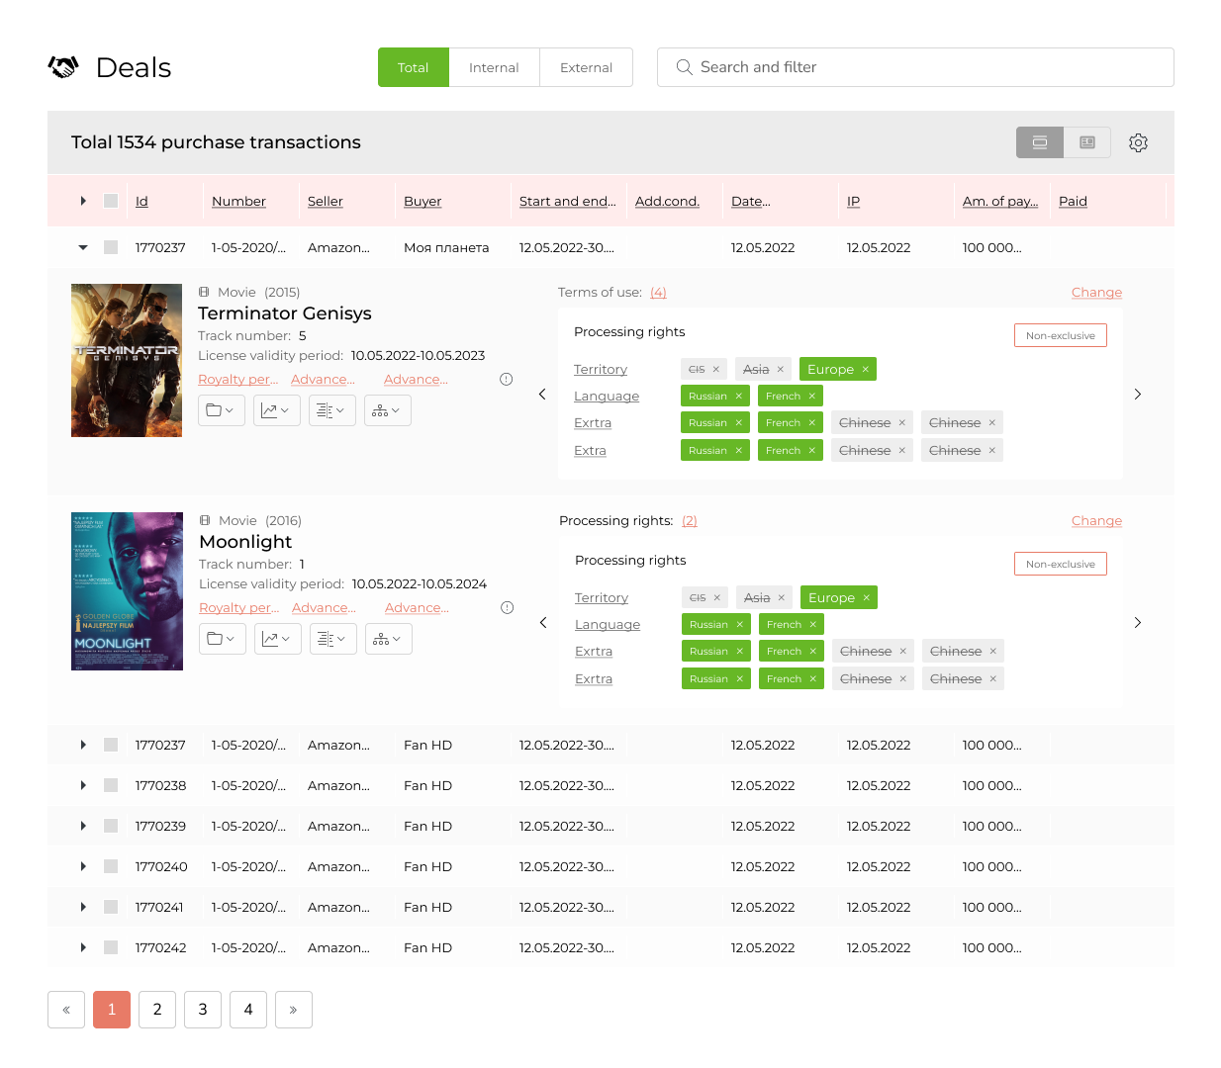
One platform for everything
Manage the register of intellectual property objects, with control of copyrights and licensing transactions.
Keep a register production and licensing contracts with automatic calculation of debts to counterparties.
Sign licensing deals on the licensing marketplace in digital way
Automatic reporting of usage the catalog content in TV, radio broadcasts and streams.
Rights reports - on the of rights availability, rights termination, sold rights.
Financial reporting engine - to control all financial flows in your company
Importing engine - to import catalog data, deals, royalty reports, etc
MR2 will help you quickly and accurately
https://www.mr2.info/
+382 (69) 57 06 60
info@mr2.info

Slide 5
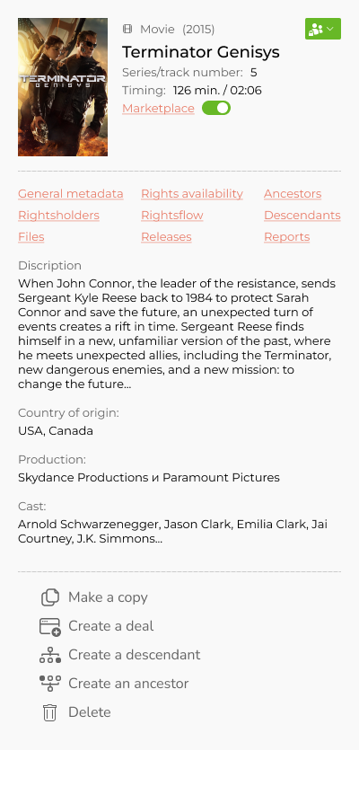
Manage the registry of available rights
Flexible metadata structure, comfortable tools to manage all fields.
Rich attributes provides flexible search and systematization
Multi-filters will help to find objects, deals and related information
Consolidated data on the rights and finances for the holding or group of companies
Access policies for rights data for each holding company, divisions, counterparties
General marketplace integrated with platform helps to sell rights directly
MR2 is invented for media companies, TV and radio broadcasters, production companies, distributors of media content
https://www.mr2.info/
+382 (69) 57 06 60
info@mr2.info

Slide 6
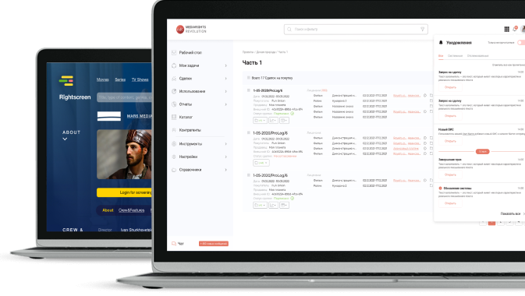
Key advantages of the platform
Copyrights, neighbours and license rights accounting
Detailed financial reports with configuration tool
Rights availability and rights expiring reports
Projects tool – new copyrights objects creation, clearing of rights
Simple API integration (bookeeping, broadcast systems, archives)
Internal transactions and consolidated reports for group of companies
Functional content storage with secured access to files
Optimize operating expenses and make rights accounting transparent and understandable
https://www.mr2.info/
+382 (69) 57 06 60
info@mr2.info

Slide 7

What can MR2 offer users
Film and animation studios, production
Full control over the company's intellectual property: deals and terms, rights in/out,
reporting, finance and analytics
Make compound rights object based on licensed rights
Rights management and deals for any objects: music, audiovisual works, scripts, characters, etc
Customers management - relationship history, rights shares control, debts calculation
Distribution in the marketplace, as an additional sales channel
Broadcasting companies
Integration with ether planning systems.
Integration with the media archive.
Rights availability by territories, methods of use, formats and other characteristics.
Automatic loading of reports from playout and calculation of royalties based on reports.
Checking of rights availability for broadcast plan and screenings booking.
https://www.mr2.info/
+382 (69) 57 06 60
info@mr2.info

Slide 8
What can MR2 offer users
Labels and production centers, digital platforms
Convenient content and metadata management. Import/export of IP objects or entire catalogs
Collaboration with contractors within the business processes
License management, contract signing and automatic search for inconsistencies
Distribution of content directly from the system to all music venues through DDEX
Publishing, synchronization, rights management and registration of content in communities
A quick and convenient mechanism for reporting to artists, contract partners.
Publishers
Content management, import/export of any amount of data
The platform fully adapts to the needs, checks metadata, ISRC code, shared access, etc
Integration with the largest authoring societies
Registration of works through the system directly in the copyright societies
Income reports import and generate reports for clients, flexible configuration of report types
A common base for all customers of the system, the ability to enter into licensing deals inside
Automation of reports and payments for all types of royalties
Under the publication based on our system
https://www.mr2.info/
+382 (69) 57 06 60
info@mr2.info

Slide 9
What can MR2 offer users
Authors, musicians, artists
Convenient content and metadata management. Import/export of OIS or entire catalogs
Collaboration with contractors
License management, contract signing and automatic search for inconsistencies
Distribution of content directly from the system to all music venues through our partner (FUGA/Merlin)
Publishing, synchronization, rights management and registration of content in communities
A quick and convenient mechanism for collecting reports and monitoring payments on them
Publishers, electronic libraries
Convenient content and metadata management. Import/export of IP objects metadata or entire catalogs
Collaboration with contractors
License management, contract signing and automatic search for inconsistencies
Publishing, rights management and registration of content in communities
A quick and convenient mechanism for collecting reports and monitoring payments on them
Selling content on a licensed marketplace
https://www.mr2.info/
+382 (69) 57 06 60
info@mr2.info

Slide 10
What can MR2 offer users
Distributors/Aggregators
Content management, simple import/export of metadata
Collaboration, distribution of roles in the system
Flexibility to set up individual accounts for your partners
Content delivery to any platforms and aggregators via DEX\DEX\XML
Distribution to the sites through our partners (optional)
Full automation of financial reports and payments
Connecting storage of any volume for storing media files
Rights Purchasing Managers
Maintaining the register of acquired rights up to date
Reminder of expiring rights and reports on the availability and use of rights to avoid double purchases, as well as for procurement planning
Means of accounting (reporting on debts to copyright holders)
Lawyers, economists, accounting
A service shared with the purchase and sale of rights for comparing the invoice of transactions (data in the rights accounting system) with stored copies of contracts and agreeing on terms
Automation of analytical reporting
Automation of debt calculations and generation of invoices for payment
https://www.mr2.info/
+382 (69) 57 06 60
info@mr2.info

Slide 11
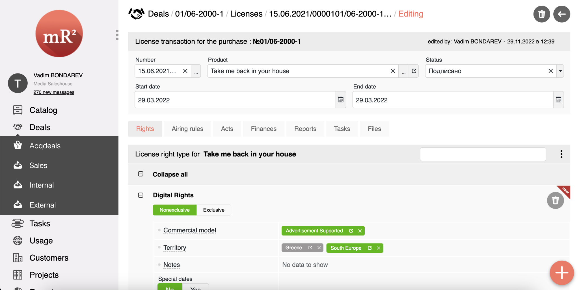
It is convenient to conduct contracts,
get results quickly
The ability to make a contract of any complexity
Control over rights availabilty when creating a sales deals or using the content
Powerful mechanism for setting up financial condition
https://www.mr2.info/
+382 (69) 57 06 60
info@mr2.info

Slide 12
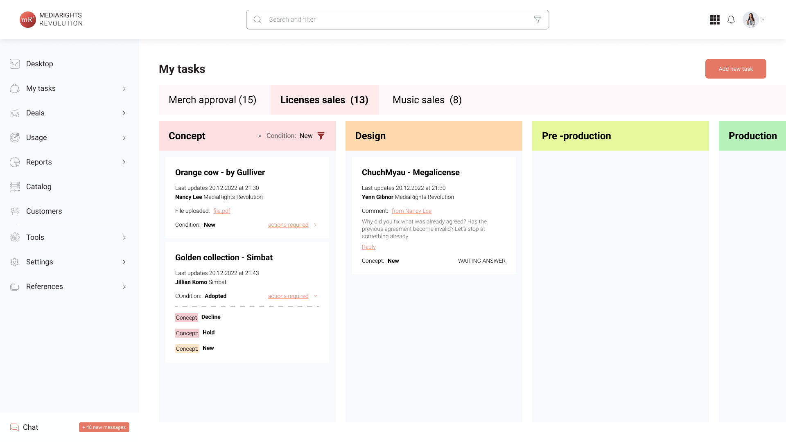
Task Manager
Manage internal tasks and external approvals
Use task templates to help define and automate the order of actions of performers or parties.
https://www.mr2.info/
+382 (69) 57 06 60
info@mr2.info

Slide 13
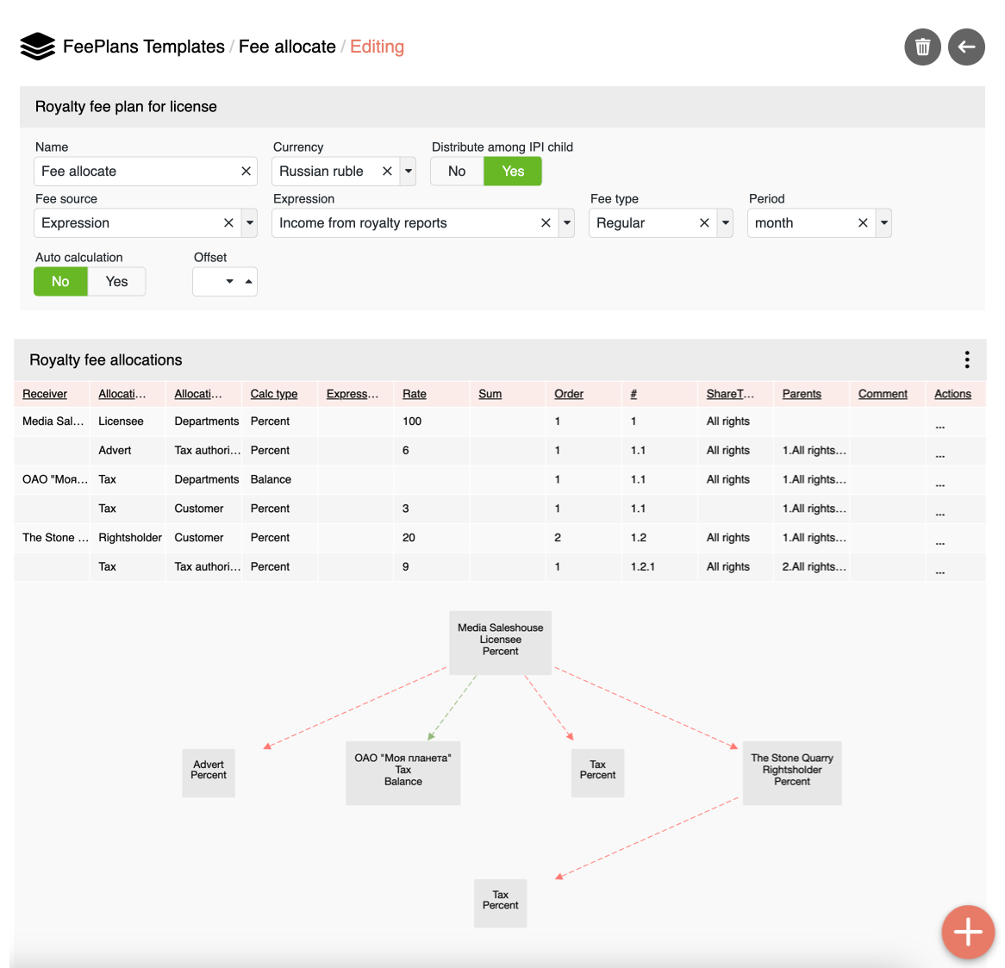
Financial conditions builder
Payment distribution builder to quick create of financial conditions on every license or deal
Support of different allocation types royalties, guarantees, mixed payments, taking into account the methods of use, territories and distribution of profits between counterparties according to shares and taxation
Formula builder to make special expressions assigning to allocations entities
For debts and payments - manual entry and recieving data from external systems
https://www.mr2.info/
+382 (69) 57 06 60
info@mr2.info

Slide 14
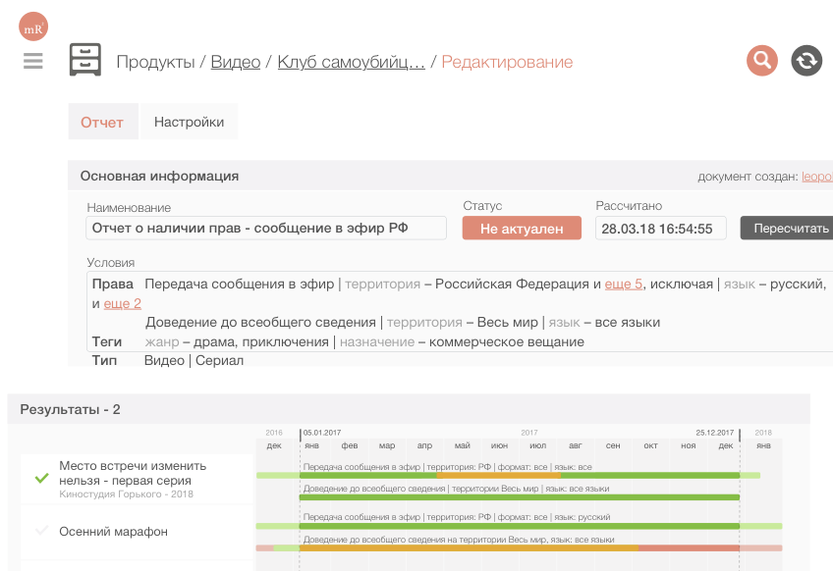
One-click calculations and reporting
Automatic calculation of accounts receivable and accounts payable
Calculate shares quick and accurately based on financial condition and debt distribution schemes
Integration with accounting systems
Reports on IP objects, deals, projects
Reports of rights availability and rights termination
Designer of user reports
Export reports data to Excel, Word
https://www.mr2.info/
+382 (69) 57 06 60
info@mr2.info

Slide 15
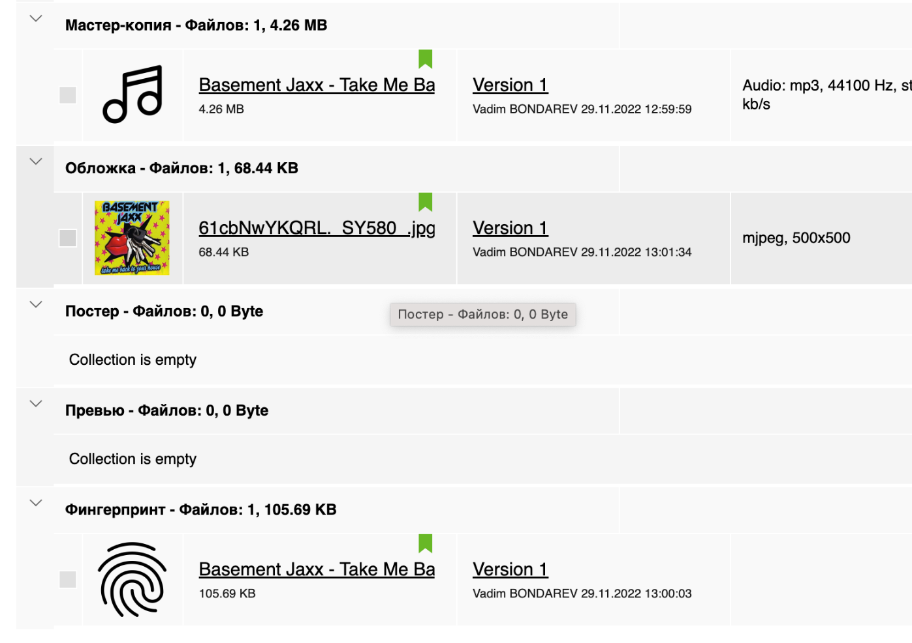
File storage and secure access
File storages for every entities in account - IP objects, Deals, Licenses, Projects, etc…
Elastic size of account storage. Use as you go
Secure files sharing with time-limit option
Preconfigured collections for different types of assets
Create user collections for all types of IP objects / for one IP object
Cloud video and music transcoding to different formats with configurable profiles
Streaming with watermarking support
Fingerprints generation
https://www.mr2.info/
+382 (69) 57 06 60
info@mr2.info

Slide 16
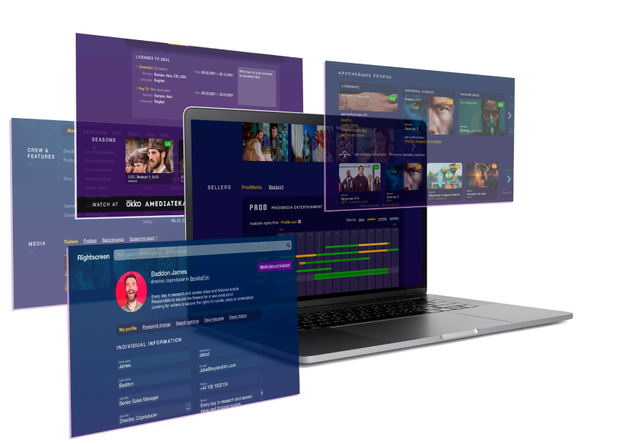
Marketplace as a new sales channel
Rightscreen's technological solutions are implemented on the basis of the Media Rights Revolution rights management platform, which allows copyright holders and licensees to make electronic transactions directly in the marketplace
Discover new markets,
increase sales and spend less time on it
with the Rightscreen licensed marketplace
https://www.mr2.info/
+382 (69) 57 06 60
info@mr2.info

Slide 17
Quality mark for copyright holders and distributors
MR2 is easily configured for the business processes of distribution, broadcasting and production companies
Reduces the cost of searching for inconsistencies in rights data, reduces the cost of maintaining license contracts and monitoring rights
Free up at least 40% of your employees' time
Increase the number of deals that 1 manager can conduct: from 3-5 deals per month without MR2, up to 50-70 per month with MR2
It will help companies grow without increasing the salary fund.
The use of MR2 will lead to an average revenue growth of 15%
We will be there to help at all stages of implementation
https://www.mr2.info/
+382 (69) 57 06 60
info@mr2.info

Slide 18


Contacts
Vadim Bondarev
CСO MediaRights Revolution, Rightscreen
by «ProLog»
vadim.bond@mr2.info
+382 69570660
https://www.mr2.info/
+382 (69) 57 06 60
info@mr2.info

